Slide 1
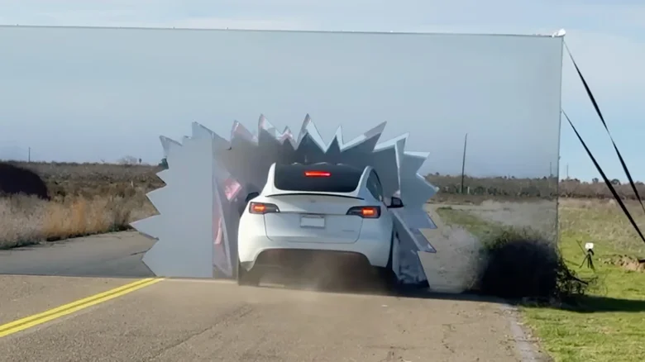
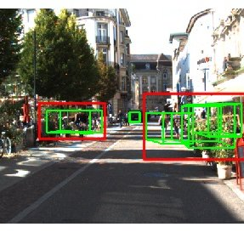
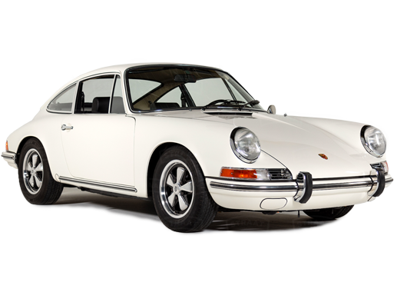
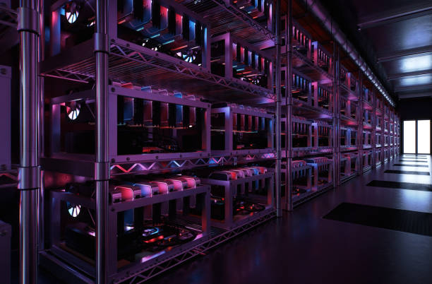
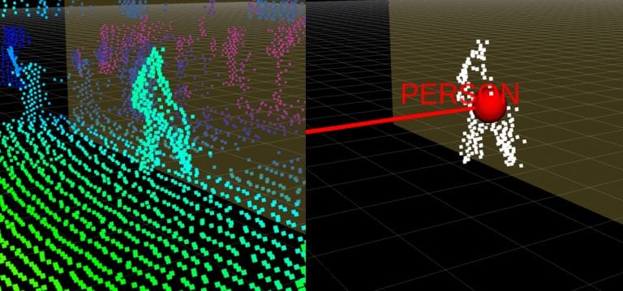
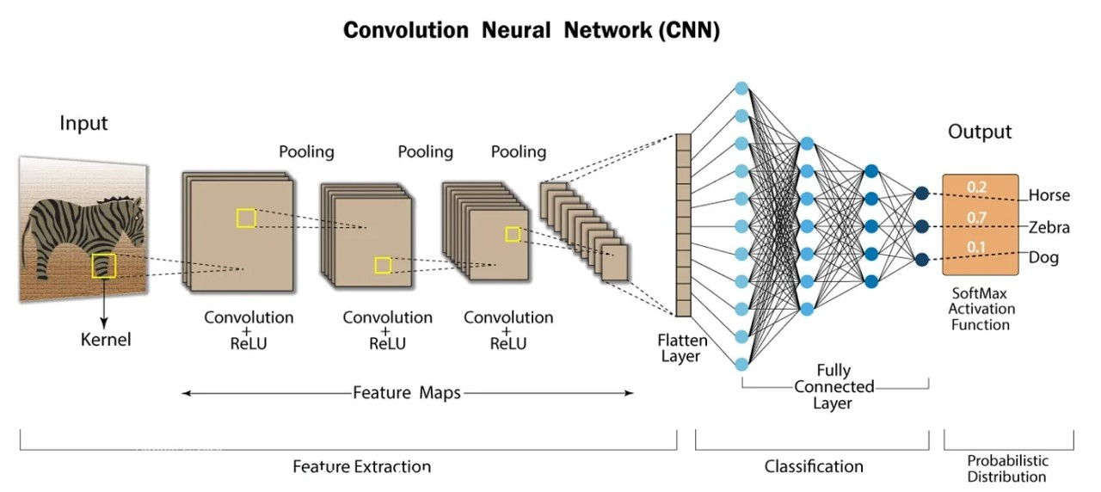
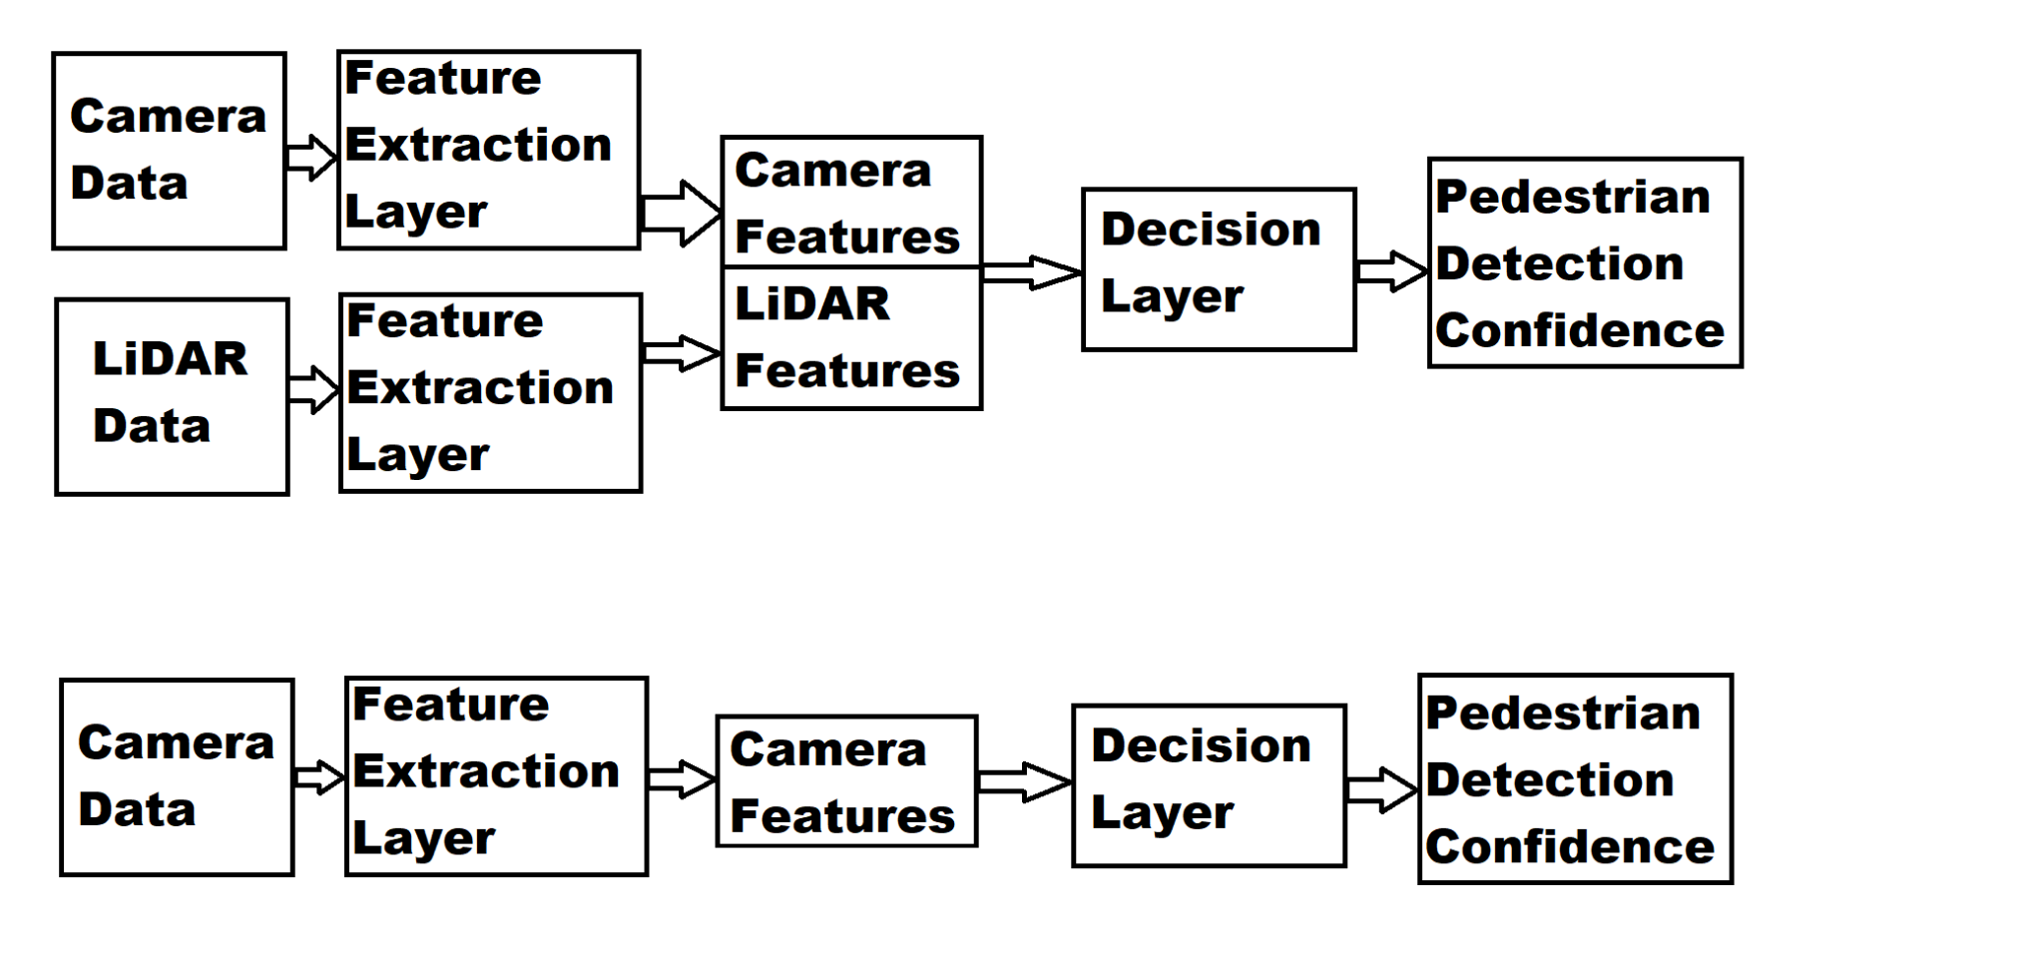
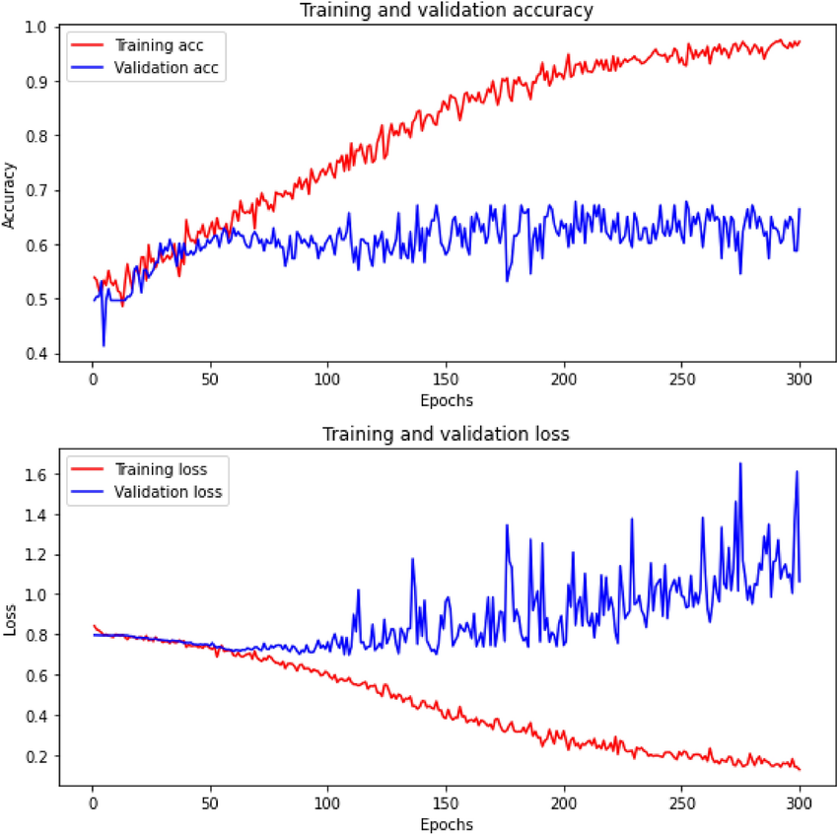

25-344
LiDAR and Camera Sensor Data Fusion for Human Detection
Team members: Paul Reid, Jeffrey Weaver, Grace Gilliam, David Anthony | Faculty adviser: Changqing Luo, Ph.D. | Sponsor: DOD Aspire | Mentor: James Perea
Project Objective:
Key Motivations:
Safety Enhancement: Current single-sensor systems have critical blind spots. Need for redundancy in safety-critical decisions
Technical Innovation: Develop novel sensor fusion architecture. Optimize for resource-constrained deployment.
Industry Relevance: Address real-world autonomous driving challenges. Provide benchmarkable results using public dataset.
Data Flow
Project Timeline
Data
Planning:
Our project aims to enhance pedestrian detection in autonomous driving scenarios by developing an optimized CNN architecture trained on Waymo datasets, incorporating comprehensive data analysis and advanced training strategies to improve detection accuracy across diverse real-world conditions.
Data Collection
The fundamental objective of this project is to develop and validate a multi-modal human detection system that enhances autonomous vehicle perception by combining LiDAR and camera sensor data from the Waymo Open Dataset. Our system addresses critical safety challenges in autonomous driving by leveraging complementary sensor strengths - LiDAR's precise depth perception and spatial awareness alongside cameras' rich visual context and semantic understanding. The architecture features real-time sensor fusion with adaptive weighting mechanisms, dynamically adjusting to environmental conditions while maintaining processing times under 100ms.
Data Preprocessing:
Gather and preprocess the Waymo Open Dataset, focusing on LiDAR and camera sensor data. Filter, label, and augment data to cover diverse real-world scenarios for robust training. Develop initial scripts for preprocessing steps, including noise reduction for LiDAR and image normalization for camera data.
Disclaimer: Our neural network is comprised of a combination of MVX-net and EfficentB0 architectures
Examples of better images
Model Architecture Design + Dev:
Design a Convolutional Neural Network (CNN) optimized for multi-modal sensor fusion. Experiment with different fusion methods to combine LiDAR and camera data. Implement the adaptive weighting mechanism to dynamically adjust sensor contributions based on environmental conditions. Develop the real-time processing pipeline to ensure processing times remain under 100ms.
Potential Challenges and Limitations
Some problems/challenges that this project encounters are 1. Synchronization challenges between LiDAR and camera data:
This stems from the idea that matching these different data representations requires complex transformations
2. Various causes of data loss in a LiDAR-camera fusion system:
This comes from random errors occurring in epochs that are unpredictable. Such errors will get marked as “lost” and the model will move forward.
Testing and Adjustments:
Perform optimization techniques, such as model pruning or quantization, to reduce computational load without sacrificing accuracy. Make final adjustments based on validation results, ensuring the system meets all real-time processing and accuracy goals. Prepare the model for deployment, ensuring compatibility with target hardware and software environments.

Slide 2
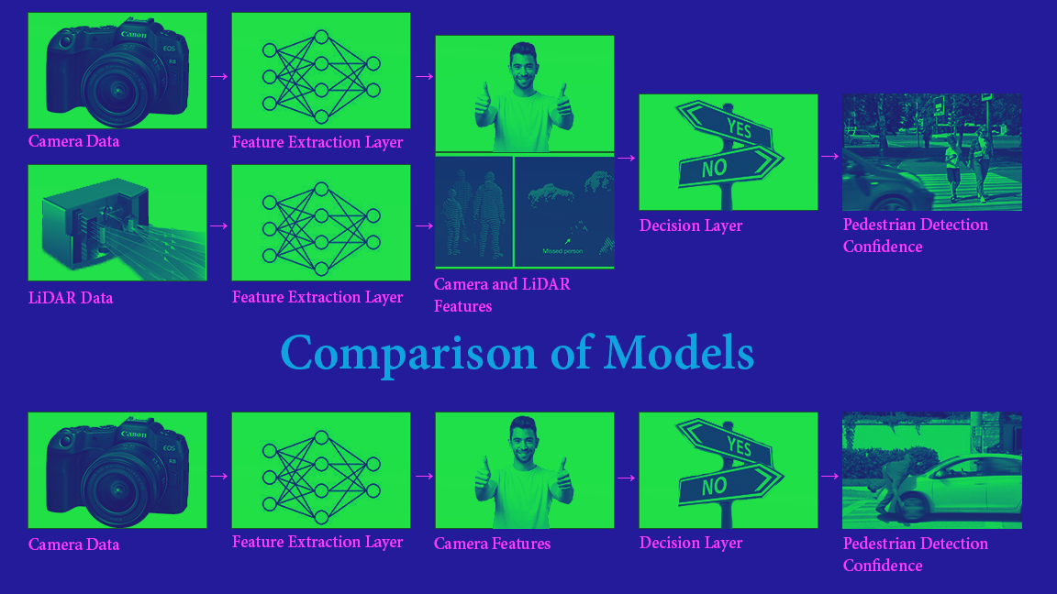
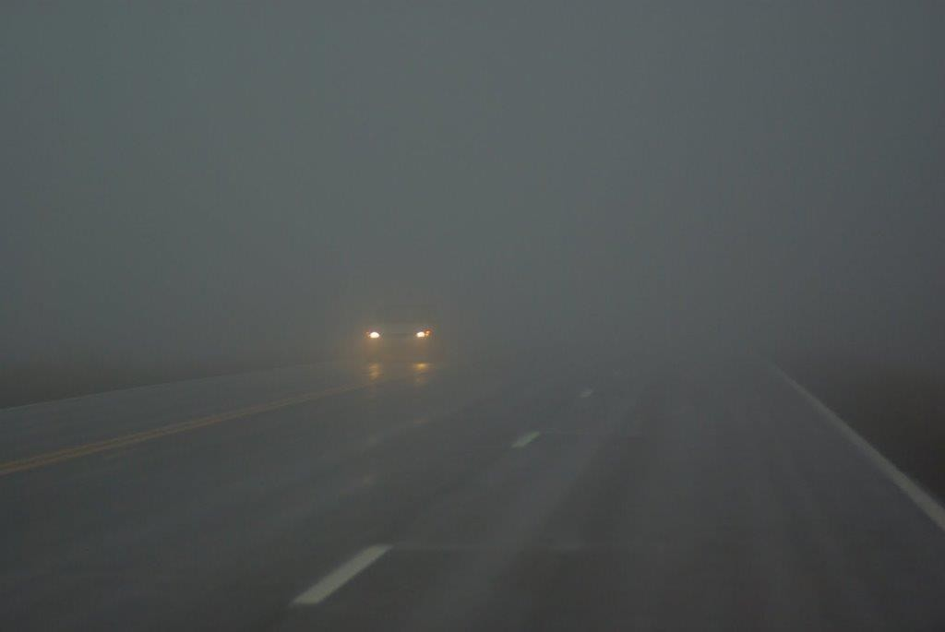
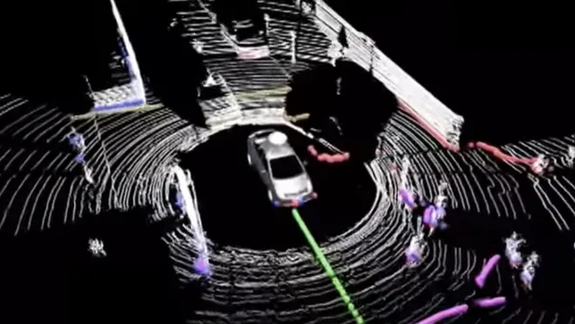
25-344
LiDAR and Camera Sensor Data Fusion for Human Detection
Team members: Paul Reid, Jeffrey Weaver, Grace Gilliam, David Anthony | Faculty adviser: Changqing Luo, Ph.D. | Sponsor: DoD Aspire | Mentor: James Perea
Project Objective:
Safety Enhancement: Current single-sensor systems have critical blind spots. Need for redundancy in safety-critical decisions.
Technical Innovation: Fusion of multimodal sensor platforms. Optimize for resource-constrained deployment.
Industry Relevance: Address real-world autonomous driving challenges.
This project investigates sensor fusion for pedestrian detection using LiDAR and RGB camera data. As modern autonomous systems increasingly rely on accurate environmental awareness, combining multiple sensor modalities has become essential for robust perception.
The Dangerous Depth Perception Gap in Single-Sensor Systems
In Mark Rober's viral testing video, Tesla's camera-only system demonstrated critical depth perception failures, colliding with a visually camouflaged wall at 40 mph that a LiDAR-equipped vehicle immediately detected.
Project Timeline:
Dta
Strategy:
Acquire datasets, transfer to VCU HPC via SLURM scripts. Implement CNN architectures for single-modality baseline and multi-sensor fusion model. Quantitatively evaluate performance improvements from secondary modality through statistical analysis
Data Collection
Data Preprocessing:
Gather and preprocess the Waymo Open Dataset, focusing on LiDAR and camera sensor data. Filter, label, and augment data to cover diverse real-world scenarios for robust training. Develop initial scripts for preprocessing steps, including noise reduction for LiDAR and image normalization for camera data.
Results:
Model Architecture Design + Dev:
Design a Convolutional Neural Network (CNN) optimized for multi-modal sensor fusion. Experiment with different fusion methods to combine LiDAR and camera data. Implement the adaptive weighting mechanism to dynamically adjust sensor contributions based on environmental conditions.
Testing and Adjustments:
Perform optimization techniques, such as model pruning or quantization, to reduce computational load without sacrificing accuracy. Make final adjustments based on validation results, ensuring the system meets all real-time processing and accuracy goals. Prepare the model for deployment, ensuring compatibility with target hardware and software environments.

Slide 3
Single Modality
Multi Modality
Results
Objective
issues with single-sensor detection systems

